Slide 1
Marking up the World with Markdown simple text based editing for Html content
Rick Strahl
West Wind Technologies
west-wind.com
weblog.west-wind.com
session materials: https://github.com/RickStrahl/SWFOX2018_MarkdownWithFoxPro

Slide 2
What is Markdown?
HTML Editing is a Pain
HTML Tag Soup
Direct editing of HTML for anything but layout is futile
Markdown represents HTML as Text
Text based markup language
Uses simple directives to represent common HTML concepts
Simple syntax that’s easy to learn
Very portable
Sharable
Great for developer text
Markdown and HTML
Markdown syntax supports limited HTML features
Markdown is a superset of HTML

Slide 3
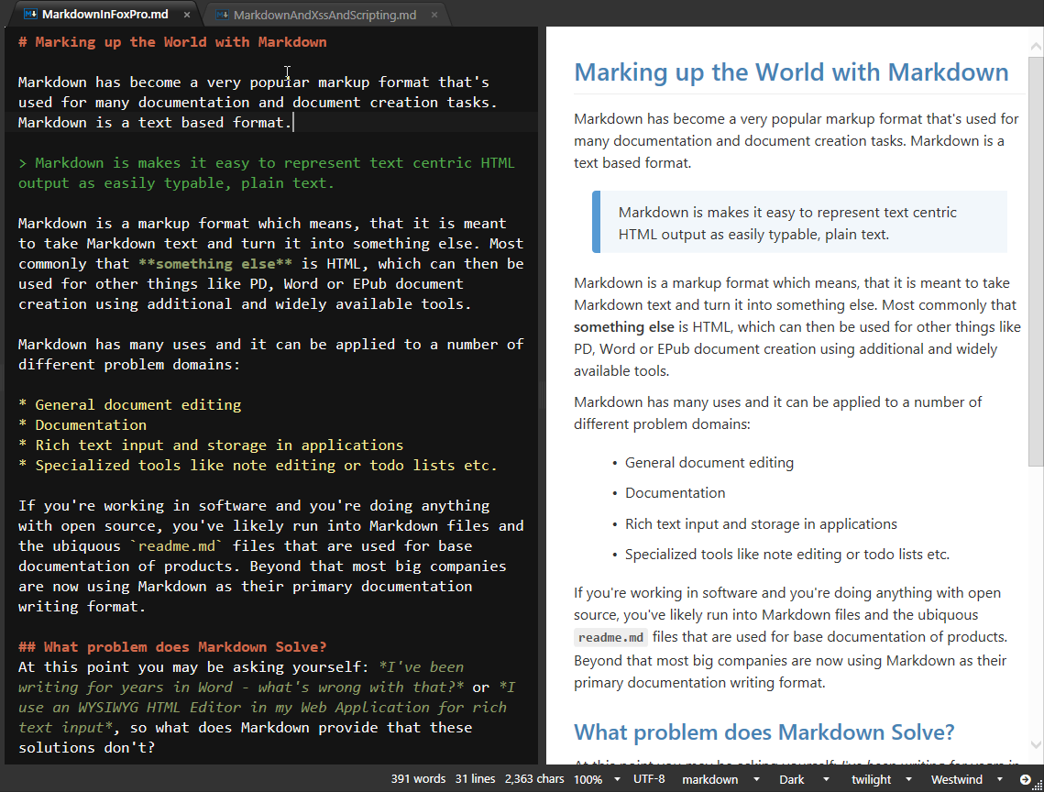
What does Markdown Look Like?

Slide 4
Why Markdown?
Plain Text
No special Editors
Notepad or Editbox works
HTML represented as plain text
Simple
Easy to learn
Easy to type and edit
Raw Document Editing
You always see the raw Markdown
Any tooling adds raw Markdown you can look at and learn from
Productivity
Plain text is less distracting
Fast for writing

Slide 5
Why Markdown (continued)
Edit with any Editor
No special tooling required
Use Notepad, an Editbox or <textarea> on the Web
Easy to Compare and Share
Plain text works great for Source Control Merging
Documentation solutions *love* Markdown
Most source code repos render Markdown as HTML
Fast
Markdown is edited as plain text
Plain text allows for fast and efficient editors
Developer Friendly
Works with any text editor – including your favorite!
Easy support for code block embedding as plain text
Markdown is portable – easy cut and paste
Extensible – Easy to build tooling for editing and output customization

Slide 6
Markdown for Writing & Documentation
Markdown is everywhere for Documentation
Uquititous for developer documentation solutions
Github, BitBucket, Microsoft Docs have native Markdown rendering support
Editing and preview support
Fast editing
Content Focused
Easy to Compare, Easy to Share
Markdown is text and so can be merged with Git
Markdown documents are easy to share in source code repositories
Source code repos have native Markdown rendering support
Extensible
Easy to customize Markdown Rendering from text
Possible to build sophisticated tooling around Markdown
Lots of Markdown based document solutions exist (ePub,Pdf,revealJs etc)
Even creating a custom editor is not rocket science

Slide 7
Markdown as static Web Content
Markdown is HTML
Markdown is easier to create than HTML
Useful for non-layout blocks of text or entire pages
Unlike HTML, can be edited by non-technical people
HTML Islands
Small blocks of Markdown inside of larger documents
Useful for largish blocks of text
Great for static sites
Easier to maintain than HTML text
Markdown Documents
Similar to the way Github/BitBucket serve Markdown
Simple to create pages on disk and served as Web content
Load Markdown output into a page/site template

Slide 8
Markdown for Applications
Anywhere you need rich text input
Replace text edit fields with Markdown fields
Useful both in Web or Desktop applications
Web and Desktop Apps
Natural fit for Web applications
Easy to build a mini editor in TextArea
Capture markdown and simply render out on display
Desktop can use Web Browser Control to preview output
Application Use Cases
Product catalog for an inventory system
User notes for any CMS style application
Messages posted to a support message board
Classifieds listings
Documentation system where Markdown is stored in a db

Slide 9
Markdown in FoxPro
Using MarkDig .NET Parser

Slide 10
Markdown Parsing
Markdown has to be parsed to HTML
Markdown is just formatted text
Markdown has to be turned into HTML to be useful
Markdown can also be turned into other formats (PDF, WPF Layout etc)
You need a Parser to Convert
Recommend using .NET with wwDotnetBridge
Several parsers are available
Parser of Choice: MarkDig .NET Parser
Very fast processing
Provides many Markdown Extension features in box
Easily extensible for custom features
Creating a Wrapper MarkdownParser Class
Provide a class for encapsulating .NET logic
Provide a simple Markdown() helper function

Slide 11
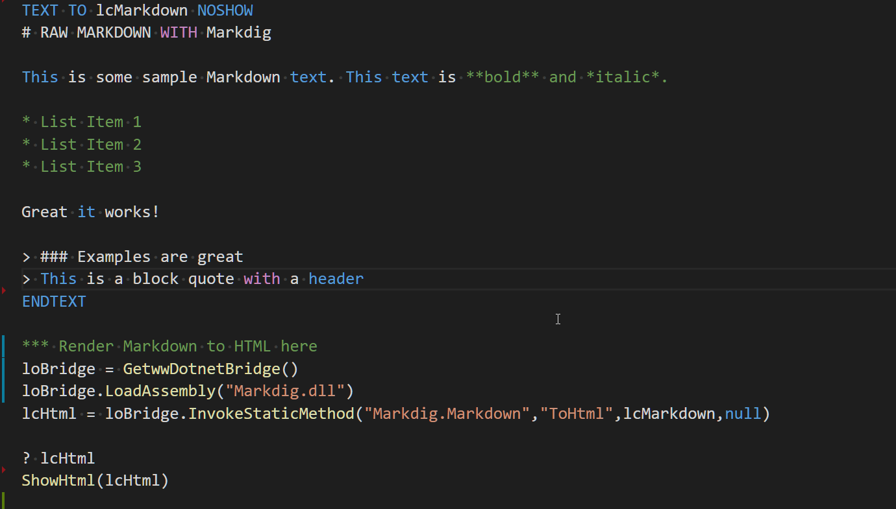
Raw Markdown with Markdig

Slide 12
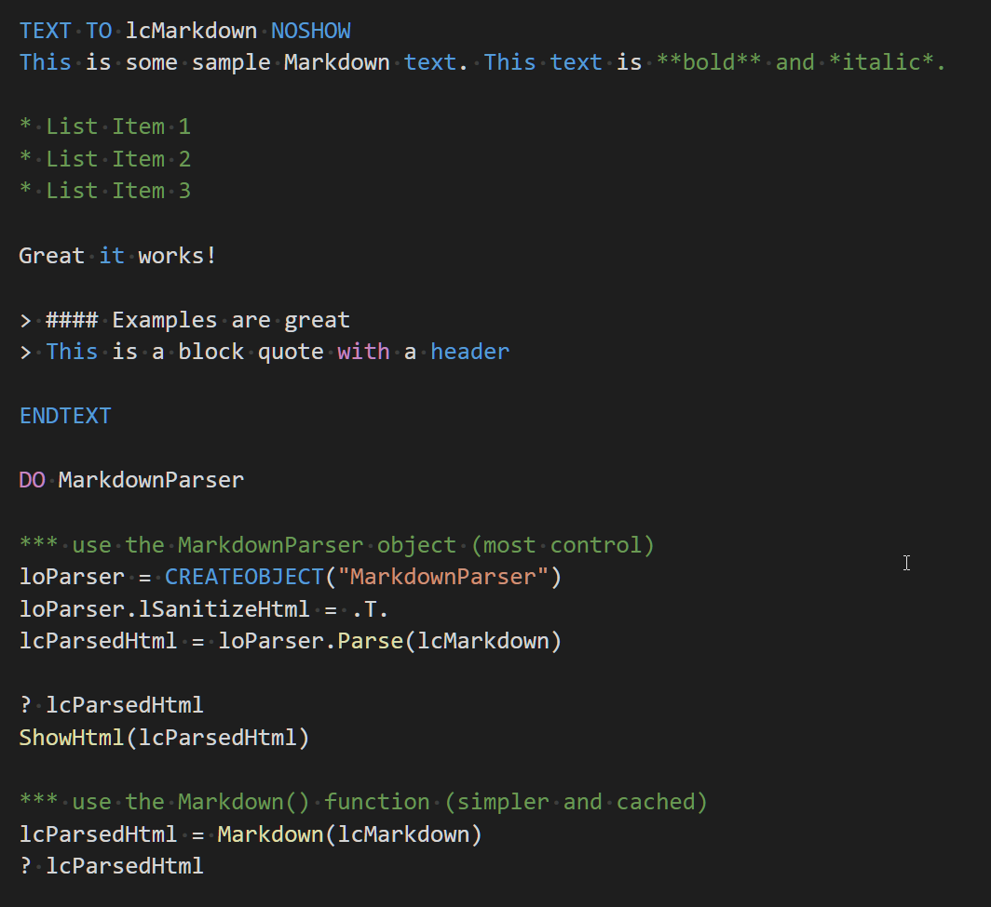
Using MarkdownParser Wrapper

Slide 13
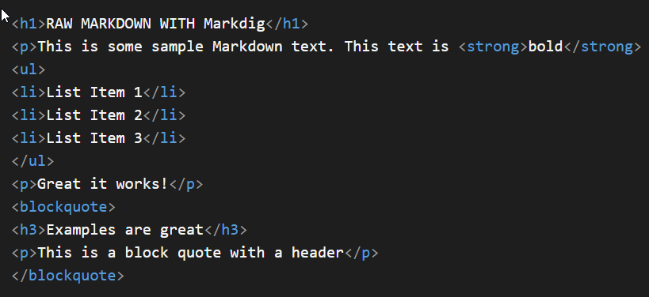
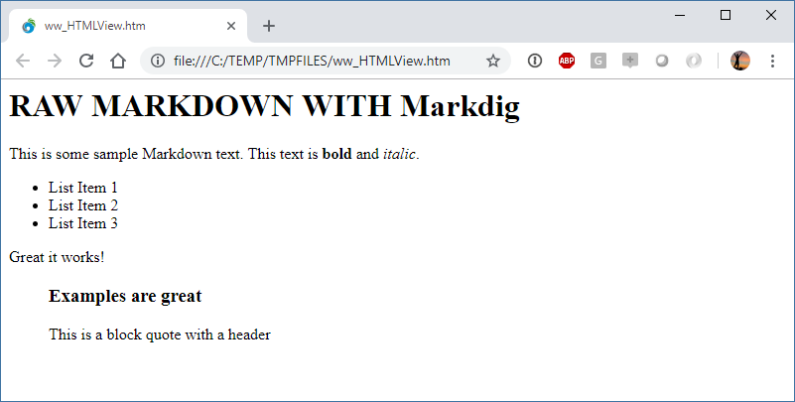
Markdown Output is an HTML Fragment

Slide 14
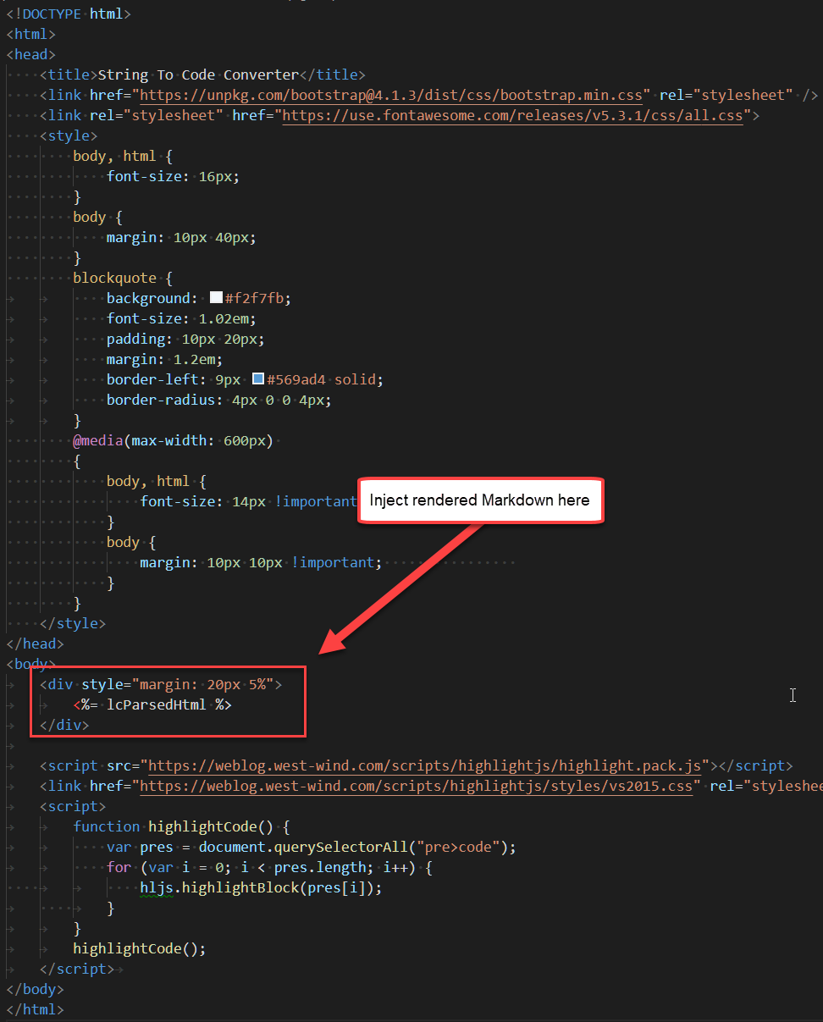
Output needs a Host Page
Markdown Output needs to be Hosted
Generated HTML needs a Host Page
Host Page provides the actual styling
Host Page should provide a container for fragment
Natural on the Web
Local Rendering
No host page available
Create a local HTML template
Inject rendered HTML into the template
Syntax Coloring
Syntax Coloring requires a JS Library
I like: highlightJS
Usually applied on common CSS structure: <pre><code class="language-XXX"> … code here </code></pre>

Slide 15
Markdown in Web Connection
Markdown is a perfect fit for Web Apps
Web Connection has built in support for Markdown
Markdown Parsing
Markdown Islands in Scripts and Templates
Markdown Page Handler
Web Connection Markdown Features
MarkdownParser class
MarkDown() function
Markdown Islands: <Markdown></Markdown> in Scripts/Templates
Any static Markdown file with an `.md` extension rendered to HTML

Slide 16
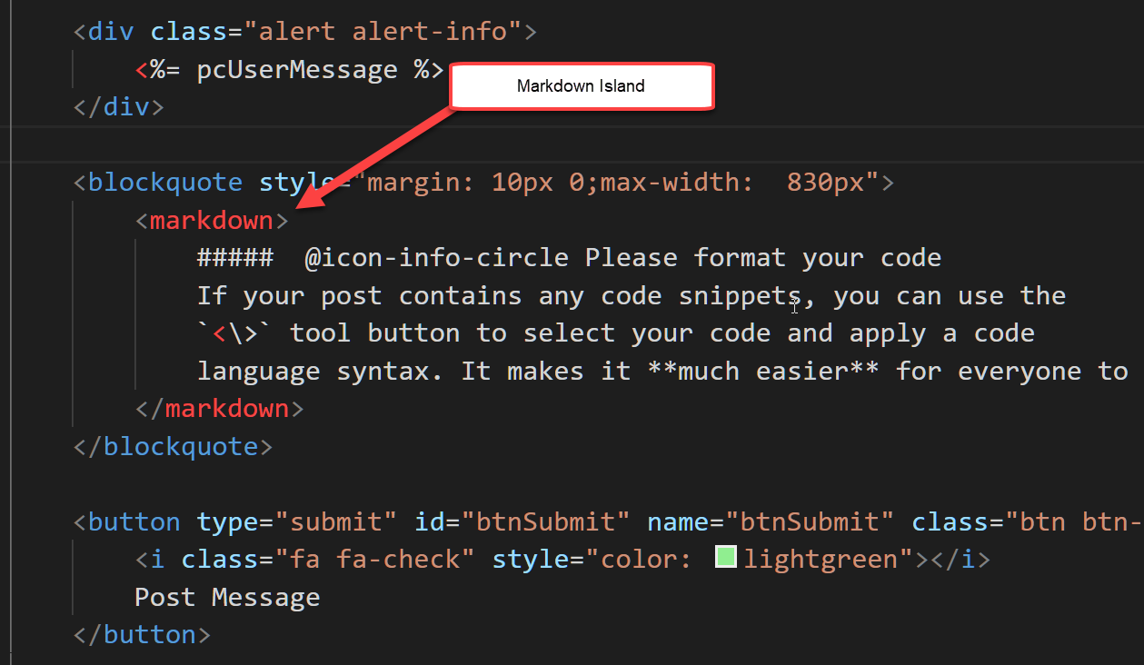
Markdown Islands (scripts and templates)

Slide 17
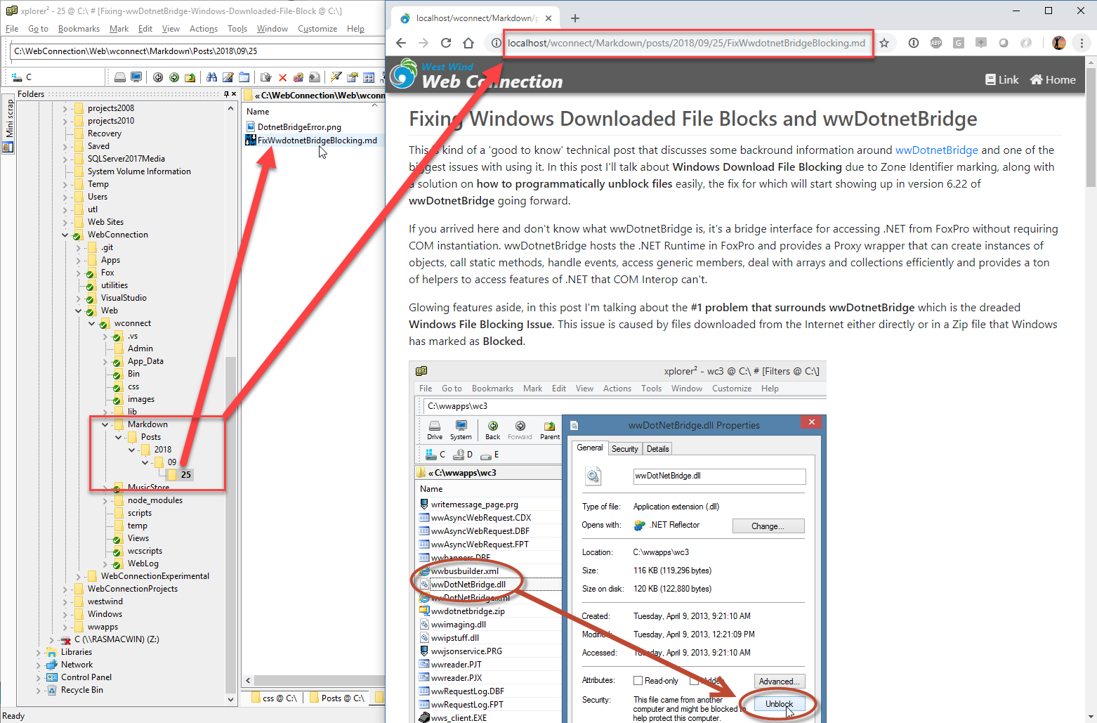
Markdown Page Handler

Slide 18
Static Web Site Management
Markdown is great for Web Content
About Pages
Privacy Policy
Content as Markdown
Example: Host your own Blog
Simply publish Markdown file + images to your site
Markdown Parser that knows to render .md files
Find a useful folder structure: https://mySite.com/posts/2018/09/17/My-Title.md

Slide 19
HTML Sanitation
User Markdown Input is Dangerous
Markdown is HTML – raw HTML is allowed
Treat User Markdown Input as you would raw HTML Input!
Sanitize your HTML
Markdown output is susceptible XSS Attacks
It’s important to sanitize Markdown user Input
Remove <script> tags
Remove javascript: directives
Remove onXXX events
Turn off Scripts
Editors can disable script execution
Use lSanitizeHtml in FoxPro HTML parser
Sanitation is on by default

Slide 20
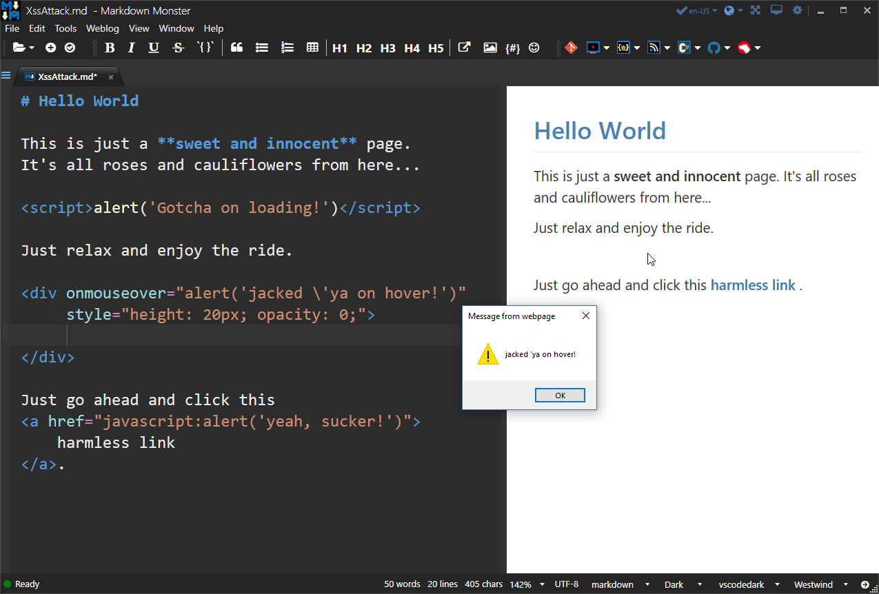

Slide 21
Markdown Usage Examples
Ways that I use Markdown on a regular basis

Slide 22
GitHub and Open Source
Social Source Control Sites
If you look at Open Source Projects: Docs and announcements are in Markdown
Github, BitBucket, Visual Studio Online etc.
Markdown is ubiquitous for documentation
Any repositories using GIT tend to use Markdown
Documentation
Markdown use for all announcement and documentation
Project descriptions
Changelogs
Documentation
Wikis

Slide 23
Documentation Creation
Markdown as a Documentation Format
Easy to write
Easy to integrate into Tooling
Raw Markdown Documents
Support in Source Code Repositories
All support direct display of Markdown as HTML
Specific tools for Documentation
Github Wikis, Atlassian Docs
Dedicated Tools
Tools can make documentation creation easier
Easier topic linking
Helpful tooling to bring in external content (images/links)
Doc Tools I’ve Built using Markdown
Html Help Builder
KavaDocs
Markdown Monster

Slide 24
Application Integration
Markdown for any Memo style Text
Any application that stores block text can benefit from Markdown content
Application stored Text
Inventory Item Listings on a Web Site
Message board Topics
Examples:
Html Help Builder – Topic fields use Markdown
KavaDocs – Using Markdown files (plus Yaml headers) for docs
Web Store – Inventory descriptions as Markdown
Message Board – Message content stored as Markdown

Slide 25
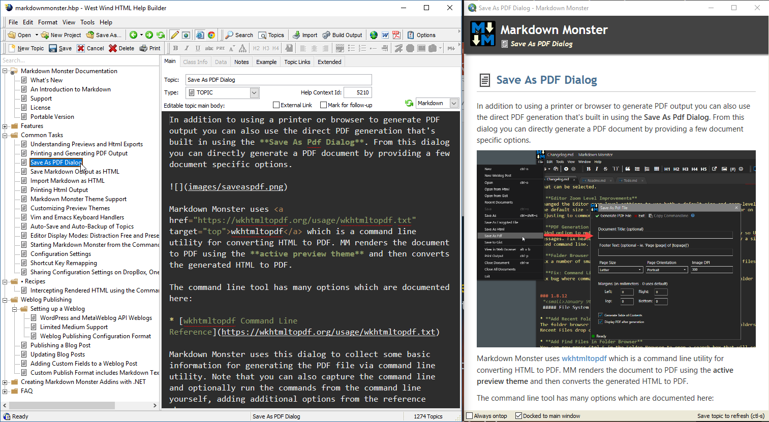

Slide 26
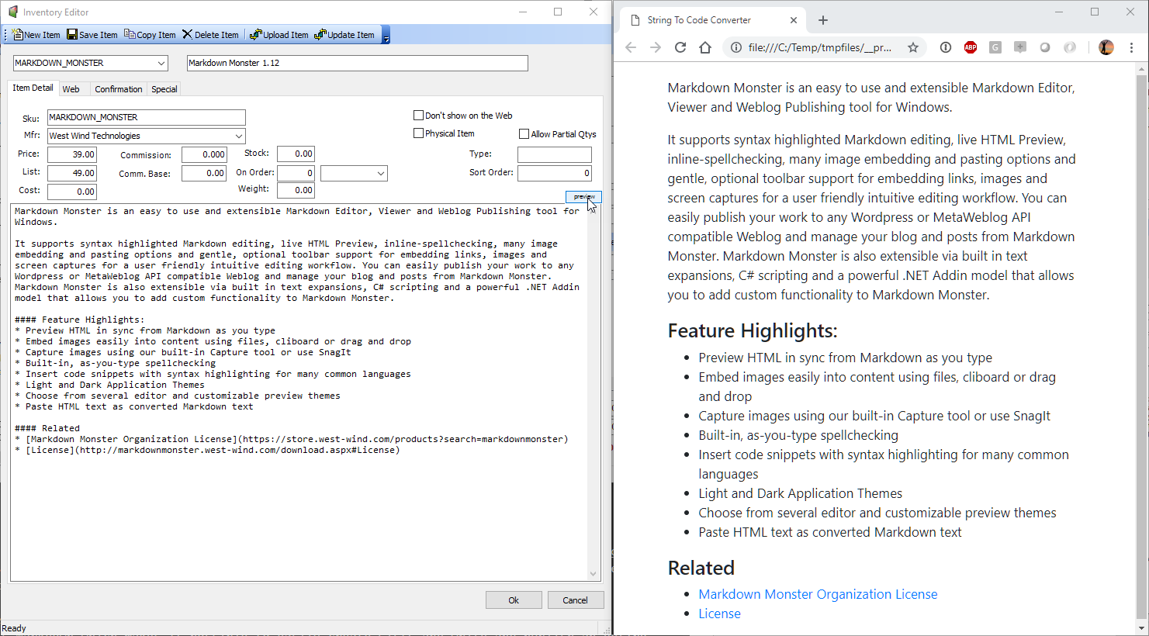

Slide 27
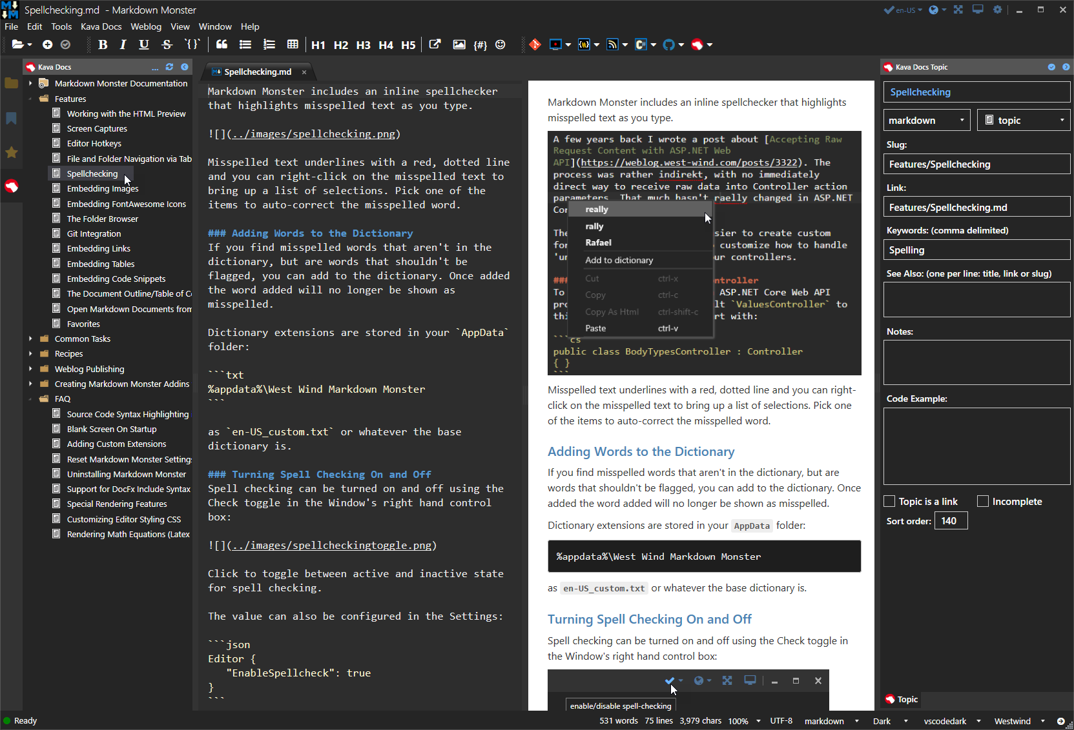

Slide 28
Code Snippets and MicroBlogging with Gists
GitHub Gist
Code Snippet Sharing Site
Post code – share link on Social Media/Email
Snippets are API accessible and are embeddable
Has support for Markdown
Use Cases
Obviously: Code Snippet Sharing
Micro-blogging: Quick way to publish Markdown Content
Online Markdown Storage
Extended Code Snippet Sharing
Prefer to use Markdown than specific file syntax
Use Markdown instead of specific Code Snippet
Use Gist as Shared File Storage
Use Gist to store Markdown for say a Blog post
Application can load the Markdown from Gist via API

Slide 29
Notes and Lists
Notes
General Notes
Call Log
Client Specific Notes
Store Files and Folders to Categorize
Lists
Todo Lists
Work Items
Share using DropBox, OneNote etc.
Easy to share documents across machines these days
Shared ‘clipboard` to share text across machines
Other Useful Features
Markdown Monster: Favorites to easily access common files/folders
Markdown Monster: Save encrypted Files for sensitive information

Slide 30
Summary
Markdown Rocks
Easy to use
Easy to integrate into applications
Easy to extend and customize
Markdown is wildly popular
Used for most things documentation
Used for just about all open source documentation
Good to be familiar with
Markdown is addictive
For me it has been a game changer
Cleaner more organized Workflow
Consolidated a ton of different tools into one

Slide 31
Thank you!
Resources
Github: Source Code, White Paper and Slides https://github.com/RickStrahl/SWFOX2018_MarkdownWithFoxPro
Contact Rick
@RickStrahl on Twitter
https://weblog.west-wind.com
https://west-wind.com/wconnect/weblog/
rstrahl@west-wind.com

